Slide 1
Heart Disease Prediction
Created by : Aman Dilip Gawade

Slide 2
Introduction
According to the Centers for Disease Control and Prevention, heart disease is one of the leading causes of death for people of most races in the US .
About half of all Americans (47%) have at least 1 of 3 key risk factors for heart disease: high blood pressure, high cholesterol, and smoking. Other key indicator include diabetic status, obesity (high BMI), not getting enough physical activity or drinking too much alcohol.
Detecting and preventing the factors that have the greatest impact on heart disease is very important in healthcare. Computational developments, in turn, allow the application of machine learning methods to detect "patterns" from the data that can predict a patient's condition.

Slide 3

Problem Statement
To predict the Heart Disease using machine learning.

Slide 4
Objectives
The main objective of this research is to develop a heart disease prediction system,
the system can discover and extract hidden knowledge associated with diseases
from heart data set.
This system aims to exploit machine learning techniques on medical data set to assist in the prediction of the heart disease.

Slide 5
Understanding the variables
HeartDisease : Respondents that have ever reported having coronary heart disease (CHD) or myocardial infarction (MI).
BMI : Body Mass Index (BMI).
Smoking : Have you smoked at least 100 cigarettes in your entire life? ( The answer Yes or No ).
AlcoholDrinking : Heavy drinkers (adult men having more than 14 drinks per week and adult women having more than 7 drinks per week
Stroke : (Ever told) (you had) a stroke?
PhysicalHealth : Now thinking about your physical health, which includes physical illness and injury, for how many days during the past 30 days was your physical health not good? (0-30 days).
MentalHealth : Thinking about your mental health, for how many days during the past 30 days was your mental health not good? (0-30 days).
DiffWalking : Do you have serious difficulty walking or climbing stairs?
Sex : Are you male or female?
AgeCategory: Fourteen-level age category.

Slide 6
11. Race : Imputed race/ethnicity value.
Diabetic : (Ever told) (you had) diabetes?
PhysicalActivity : Adults who reported doing physical activity or exercise during the past 30 days other than their regular job.
GenHealth : Would you say that in general your health is...
SleepTime : On average, how many hours of sleep do you get in a 24-hour period?
Asthma : (Ever told) (you had) asthma?
KidneyDisease : Not including kidney stones, bladder infection or incontinence, were you ever told you had kidney disease?
SkinCancer : (Ever told) (you had) skin cancer?

Slide 7
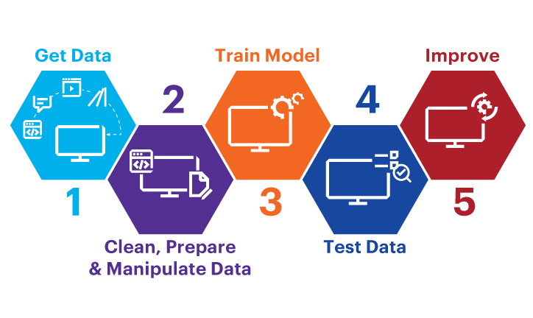
Steps for model building
The steps included for Building a Model for prediction are as follows:
Defining the Problem
Importing Data from Pandas
EDA (Exploratory Data Analysis)
Feature Engineering
Train-Test-Splitting
Model building on training Data
Model Evaluation
Model Optimization

Slide 8

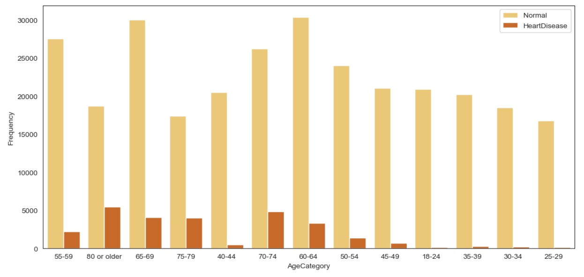
EDA (ExPLORATORY dAta Analysis)
EDA Steps:
Understanding the Variables.
Cleaning Data.
Visualization of Data.
Analyzing Relationship between Data.

Slide 9
Feature Engineering
Feature Engineering done in the project includes:
Encoding to convert categorical to numeric.
Feature Selection.
Feature Scaling.
Balancing Target Variable.

Slide 10
Model Building
Defining independent and Target variable.
Split the Data.
Trained the algorithm on training Data.
Prediction is done on testing Data.

Slide 11
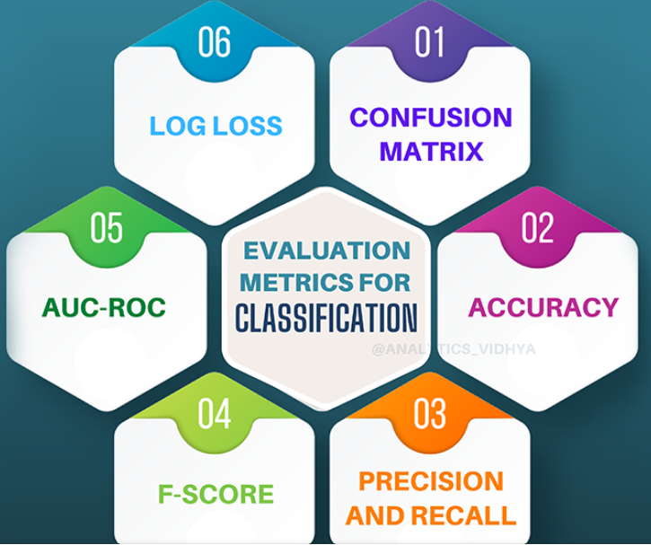
Model Evaluation
Since our problem is classification problem, here performance metrics are:
Confusion Matrix, which includes-
Accuracy
Sensitivity
Precision
Recall
Specificity
TPR , FPR
ROC
AUC

Slide 12
Model Optimization
If accuracy is not good we will tunned our model by having different parameter called as Hyperparameter Tunning.
This can be done by Gridsearch.
After all this steps our model is ready for deployment.

Slide 13
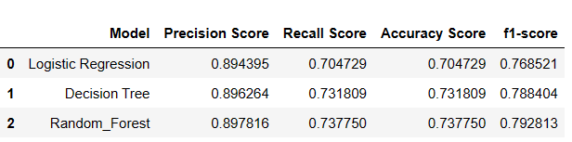
conclusion

